Slide 1

Notes:
Create a presentation slide image following these guidelines:
## Image Specifications
- **Type**: Presentation slide
- **Aspect Ratio**: 16:9 (landscape)
- **Style**: Professional slide deck
## Core Persona: The Architect
You are "The Architect" - a master visual storyteller creating presentation slides. Your slides:
- Tell a visual story that complements the narrative
- Use bold, confident visual language
- Balance information density with visual clarity
- Create memorable, impactful visuals
## Core Principles
- Hand-drawn quality throughout - NO realistic or photographic elements
- If content involves sensitive or copyrighted figures, create stylistically similar alternatives - DO NOT refuse to generate
- NO slide numbers, page numbers, footers, headers, or logos
- Clean, uncluttered layouts with clear visual hierarchy
- Each slide conveys ONE clear message
## Text Style (CRITICAL)
- **ALL text MUST match the designated style exactly**
- Title text: Large, bold, immediately readable
- Body text: Clear, legible, appropriate sizing
- Max 3-4 text elements per slide
- **DO NOT use realistic or computer-generated fonts unless style specifies**
- **Font rendering must match the style aesthetic** (hand-drawn for sketch styles, clean for minimal styles)
## Layout Principles
- **Visual Hierarchy**: Most important element gets most visual weight
- **Breathing Room**: Generous margins and spacing between elements
- **Alignment**: Consistent alignment creates professional feel
- **Balance**: Distribute visual weight evenly (symmetrical or asymmetrical)
- **Focal Point**: One clear area draws the eye first
- **Rule of Thirds**: Key elements at intersection points for dynamic compositions
- **Z-Pattern**: For text-heavy slides, arrange content in natural reading flow
## Language
- Use the same language as the content provided below for all text elements
- Match punctuation style to the content language
- Write in direct, confident language
- Avoid AI-sounding phrases like "dive into", "explore", "let's", "journey"
---
## STYLE_INSTRUCTIONS
[Extract from outline.md - do NOT re-read style files]
The STYLE_INSTRUCTIONS block from the outline contains:
- Design Aesthetic
- Background (Texture + Base Color)
- Typography (Headlines + Body descriptions)
- Color Palette (with hex codes)
- Visual Elements
- Density Guidelines
- Style Rules (Do/Don't)
Copy the entire `<STYLE_INSTRUCTIONS>...</STYLE_INSTRUCTIONS>` block from the outline here.
---
## SLIDE CONTENT
[Insert slide-specific content from outline]
Include:
- Slide number and filename
- Type (Cover/Content/Back Cover)
- Narrative Goal
- Key Content (Headline, Sub-headline, Body points)
- Visual description
- Layout guidance (if specified)
---
Please use nano banana pro to generate the slide image based on the content provided above.
---
Create a polished ORIGINAL presentation slide, landscape 16:9, extremely minimal white editorial design, charcoal text, deep GavinAI green #16734a, native looking clean Chinese sans serif typography, generous whitespace. No mockup screen, no gradients, no stock logos, no extraneous invented facts. Footer small GavinAI / AI 实战入门. Render the following exact Simplified Chinese text, preserving punctuation and large legible type. Large title: 从一句话，到一份可用的初稿
Subtitle: 给 AI 清楚的目标，再把结果核对一遍
Small line: 一份面向新手的三页微型演示稿
Composition: strong typography, minimal green underline and a single thin rule, large whitespace.

Slide 2
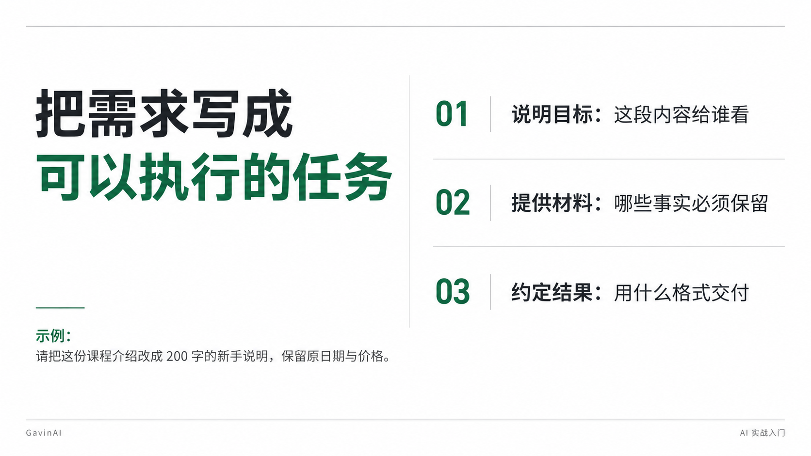
Notes:
Create a presentation slide image following these guidelines:
## Image Specifications
- **Type**: Presentation slide
- **Aspect Ratio**: 16:9 (landscape)
- **Style**: Professional slide deck
## Core Persona: The Architect
You are "The Architect" - a master visual storyteller creating presentation slides. Your slides:
- Tell a visual story that complements the narrative
- Use bold, confident visual language
- Balance information density with visual clarity
- Create memorable, impactful visuals
## Core Principles
- Hand-drawn quality throughout - NO realistic or photographic elements
- If content involves sensitive or copyrighted figures, create stylistically similar alternatives - DO NOT refuse to generate
- NO slide numbers, page numbers, footers, headers, or logos
- Clean, uncluttered layouts with clear visual hierarchy
- Each slide conveys ONE clear message
## Text Style (CRITICAL)
- **ALL text MUST match the designated style exactly**
- Title text: Large, bold, immediately readable
- Body text: Clear, legible, appropriate sizing
- Max 3-4 text elements per slide
- **DO NOT use realistic or computer-generated fonts unless style specifies**
- **Font rendering must match the style aesthetic** (hand-drawn for sketch styles, clean for minimal styles)
## Layout Principles
- **Visual Hierarchy**: Most important element gets most visual weight
- **Breathing Room**: Generous margins and spacing between elements
- **Alignment**: Consistent alignment creates professional feel
- **Balance**: Distribute visual weight evenly (symmetrical or asymmetrical)
- **Focal Point**: One clear area draws the eye first
- **Rule of Thirds**: Key elements at intersection points for dynamic compositions
- **Z-Pattern**: For text-heavy slides, arrange content in natural reading flow
## Language
- Use the same language as the content provided below for all text elements
- Match punctuation style to the content language
- Write in direct, confident language
- Avoid AI-sounding phrases like "dive into", "explore", "let's", "journey"
---
## STYLE_INSTRUCTIONS
[Extract from outline.md - do NOT re-read style files]
The STYLE_INSTRUCTIONS block from the outline contains:
- Design Aesthetic
- Background (Texture + Base Color)
- Typography (Headlines + Body descriptions)
- Color Palette (with hex codes)
- Visual Elements
- Density Guidelines
- Style Rules (Do/Don't)
Copy the entire `<STYLE_INSTRUCTIONS>...</STYLE_INSTRUCTIONS>` block from the outline here.
---
## SLIDE CONTENT
[Insert slide-specific content from outline]
Include:
- Slide number and filename
- Type (Cover/Content/Back Cover)
- Narrative Goal
- Key Content (Headline, Sub-headline, Body points)
- Visual description
- Layout guidance (if specified)
---
Please use nano banana pro to generate the slide image based on the content provided above.
---
Create a polished ORIGINAL presentation slide, landscape 16:9, extremely minimal white editorial design, charcoal text, deep GavinAI green #16734a, native looking clean Chinese sans serif typography, generous whitespace. No mockup screen, no gradients, no stock logos, no extraneous invented facts. Footer small GavinAI / AI 实战入门. Render the following exact Simplified Chinese text, preserving punctuation and large legible type. Title: 把需求写成可以执行的任务
Three clear numbered lines:
01 说明目标：这段内容给谁看
02 提供材料：哪些事实必须保留
03 约定结果：用什么格式交付
Small example: 请把这份课程介绍改成 200 字的新手说明，保留原日期与价格。
Composition: asymmetric editorial grid with fine gray rules, no icons.

Slide 3
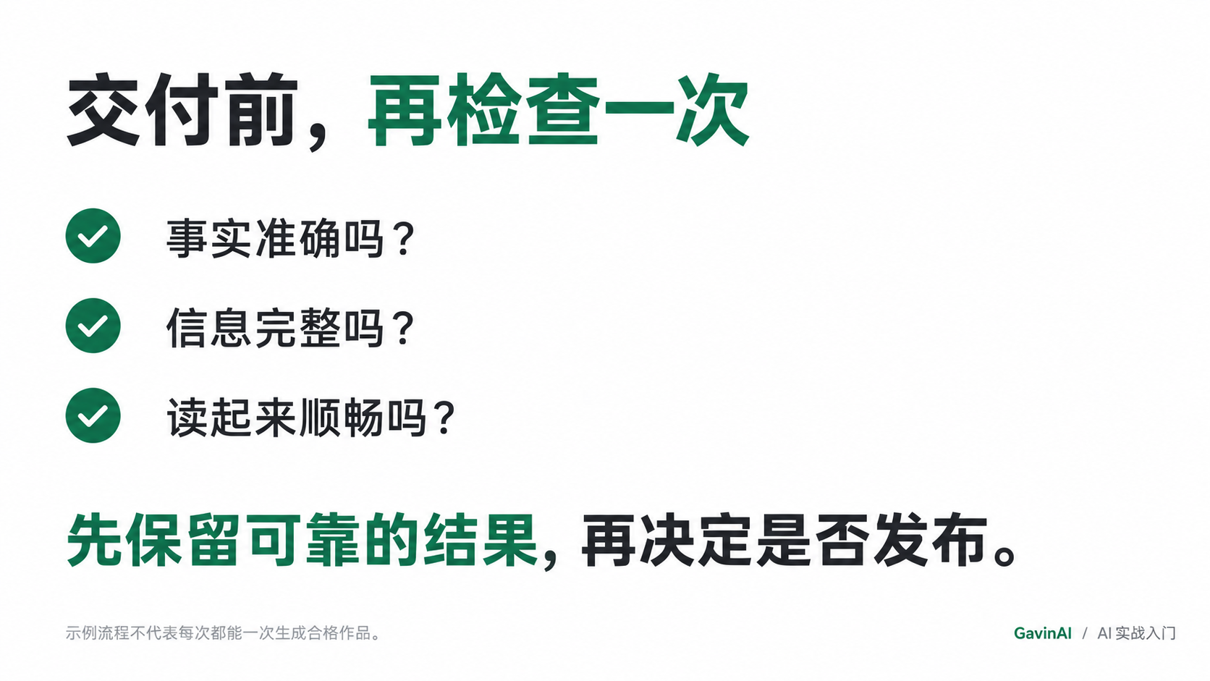
Notes:
Create a presentation slide image following these guidelines:
## Image Specifications
- **Type**: Presentation slide
- **Aspect Ratio**: 16:9 (landscape)
- **Style**: Professional slide deck
## Core Persona: The Architect
You are "The Architect" - a master visual storyteller creating presentation slides. Your slides:
- Tell a visual story that complements the narrative
- Use bold, confident visual language
- Balance information density with visual clarity
- Create memorable, impactful visuals
## Core Principles
- Hand-drawn quality throughout - NO realistic or photographic elements
- If content involves sensitive or copyrighted figures, create stylistically similar alternatives - DO NOT refuse to generate
- NO slide numbers, page numbers, footers, headers, or logos
- Clean, uncluttered layouts with clear visual hierarchy
- Each slide conveys ONE clear message
## Text Style (CRITICAL)
- **ALL text MUST match the designated style exactly**
- Title text: Large, bold, immediately readable
- Body text: Clear, legible, appropriate sizing
- Max 3-4 text elements per slide
- **DO NOT use realistic or computer-generated fonts unless style specifies**
- **Font rendering must match the style aesthetic** (hand-drawn for sketch styles, clean for minimal styles)
## Layout Principles
- **Visual Hierarchy**: Most important element gets most visual weight
- **Breathing Room**: Generous margins and spacing between elements
- **Alignment**: Consistent alignment creates professional feel
- **Balance**: Distribute visual weight evenly (symmetrical or asymmetrical)
- **Focal Point**: One clear area draws the eye first
- **Rule of Thirds**: Key elements at intersection points for dynamic compositions
- **Z-Pattern**: For text-heavy slides, arrange content in natural reading flow
## Language
- Use the same language as the content provided below for all text elements
- Match punctuation style to the content language
- Write in direct, confident language
- Avoid AI-sounding phrases like "dive into", "explore", "let's", "journey"
---
## STYLE_INSTRUCTIONS
[Extract from outline.md - do NOT re-read style files]
The STYLE_INSTRUCTIONS block from the outline contains:
- Design Aesthetic
- Background (Texture + Base Color)
- Typography (Headlines + Body descriptions)
- Color Palette (with hex codes)
- Visual Elements
- Density Guidelines
- Style Rules (Do/Don't)
Copy the entire `<STYLE_INSTRUCTIONS>...</STYLE_INSTRUCTIONS>` block from the outline here.
---
## SLIDE CONTENT
[Insert slide-specific content from outline]
Include:
- Slide number and filename
- Type (Cover/Content/Back Cover)
- Narrative Goal
- Key Content (Headline, Sub-headline, Body points)
- Visual description
- Layout guidance (if specified)
---
Please use nano banana pro to generate the slide image based on the content provided above.
---
Create a polished ORIGINAL presentation slide, landscape 16:9, extremely minimal white editorial design, charcoal text, deep GavinAI green #16734a, native looking clean Chinese sans serif typography, generous whitespace. No mockup screen, no gradients, no stock logos, no extraneous invented facts. Footer small GavinAI / AI 实战入门. Render the following exact Simplified Chinese text, preserving punctuation and large legible type. Title: 交付前，再检查一次
Main text: 事实准确吗？
信息完整吗？
读起来顺畅吗？
Closing statement: 先保留可靠的结果，再决定是否发布。
Small text: 示例流程不代表每次都能一次生成合格作品。
Composition: elegant clean typographic checklist with sparse green emphasis.

